Slide 1
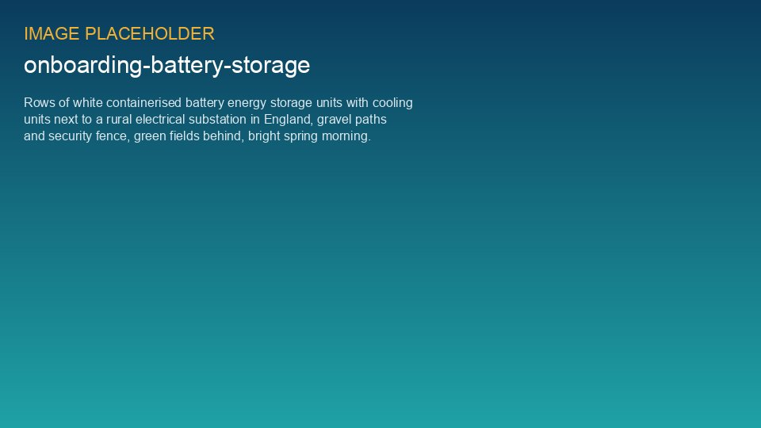
WEYLAND ENERGY
Battery storage basics
Lunch & Learn · Liam McAllister & Kwame Mensah · 18 June 2026

Slide 2
MW vs MWh
• MW = how fast you can charge or discharge (power)
• MWh = how much energy you can store (capacity)
• Millbrook BESS: 20 MW / 40 MWh → 2-hour battery
• Fenwick: 100 MW / 200 MWh → also 2 hours
WEYLAND ENERGY · Battery storage basics
2
Notes:
Water tank analogy: pipe diameter vs tank size.

Slide 3
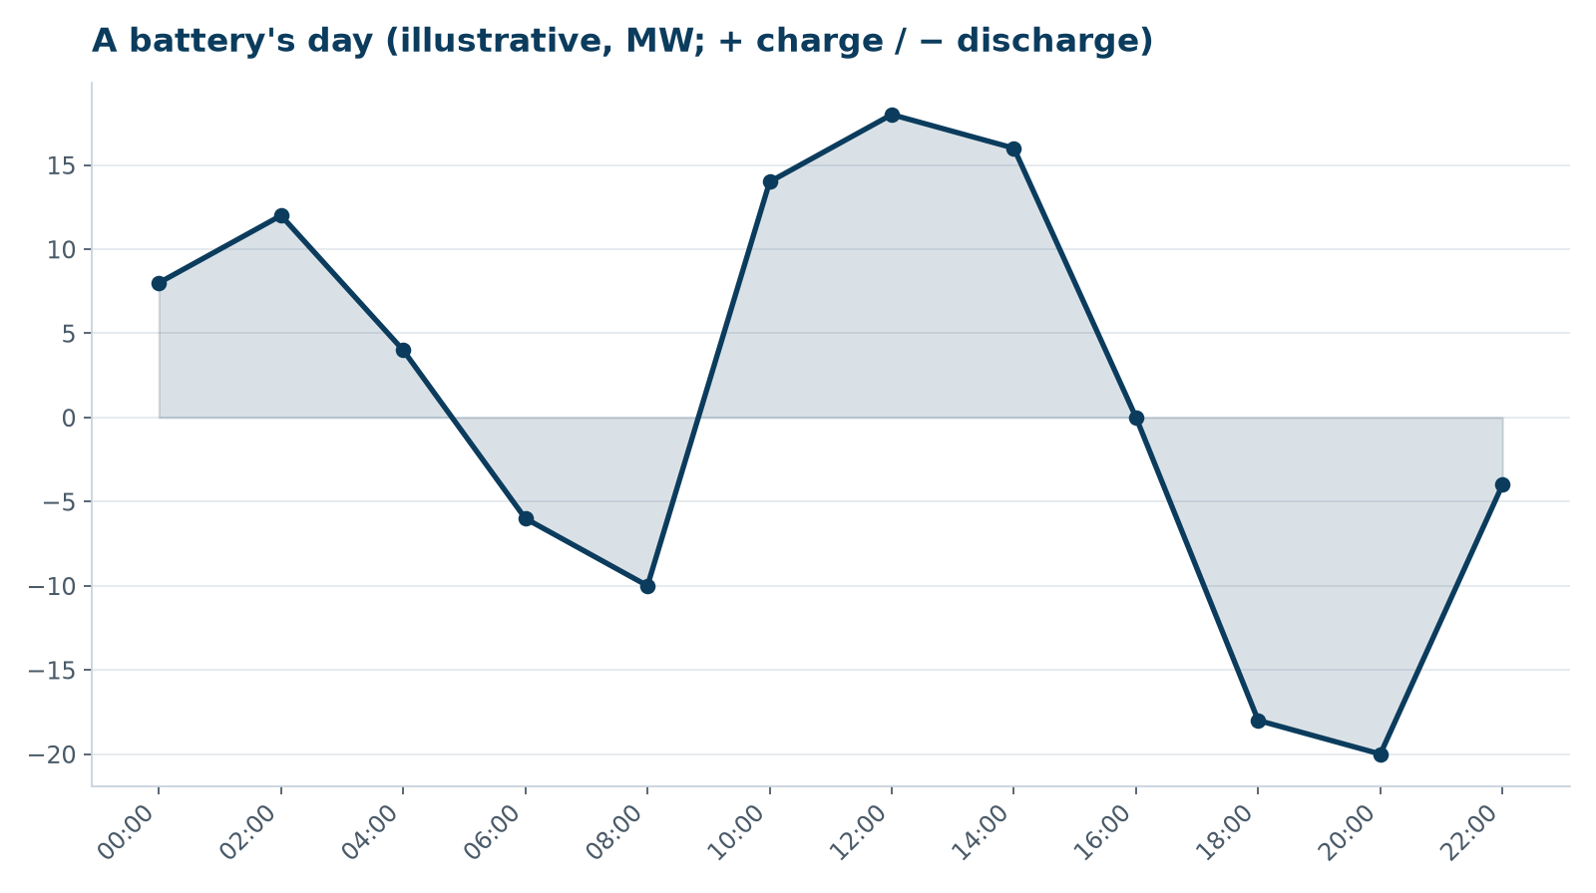
A battery's day
WEYLAND ENERGY · Battery storage basics
3

Slide 4
How batteries earn money
Revenue stream | What it is | Share (Fenwick case)
Arbitrage | Charge cheap, discharge expensive | ~ 45 %
Frequency response | Stabilise grid frequency within seconds | ~ 30 %
Capacity market | Paid for being available at peak | ~ 15 %
Balancing mechanism | Instructions from the system operator | ~ 10 %
WEYLAND ENERGY · Battery storage basics
4

Slide 5
Safety
• Lithium iron phosphate (LFP) cells – lower thermal runaway risk
• Container-level fire detection and suppression
• Spacing and fire service engagement in planning
WEYLAND ENERGY · Battery storage basics
5

Slide 6
Our storage projects
40
200
2 h
4
MWh – Millbrook (in planning, decision Q1 2027)
MWh – Fenwick (grid offer Q2 2027)
storage duration of both projects
revenue streams stacked
WEYLAND ENERGY · Battery storage basics
6

Slide 7
WEYLAND ENERGY
Questions?
Kwame Mensah · Battery Storage Developer

